Slide 1
Common Childhood Cancers
1

Slide 2
Childhood Malignancies
Childhood Malignancies
Lymphohematogenous
Leukemias
Lymphomas
Solid
Common
Others
2

Slide 3
Childhood Cancer
Incidence
Represents 2% of Malignancies
130–140 children per million annually under the age of 16 years
Around 1 out of 500 children
within the first 5 years of life is twice as high as from 6 to 15 years of age
3

Slide 4
4

Slide 5
Pecularities of Childhood Malignancies
While in adults about 80% of cancerous diseases pertain to the respiratory, gastrointestinal and reproductive organs, only <5% of cancerous diseases of children are manifested in these organs
Marked difference in histopathology from that of adults: embryonal and immature cells
The variability within a particular childhood neoplasia and in the prognosis is high
Diagnosis and therapy must be adjusted to the individual child according to the clinical manifestation and the extent of the tumor
5

Slide 6
Hematological Malignancy
The Leukemias
6

Slide 7
LEUKEMIA
Definition and General Characteristics
Uncontrolled proliferation of immature white blood cells with a different immunological subtype
Lethal within 1–6 months without treatment
The disorder starts in the bone marrow, where normal blood cells are replaced by leukemic cells
Morphological, immunological, cytogenetic, biochemical, and molecular genetic factors characterize the subtypes with various responses to treatment
7

Slide 8
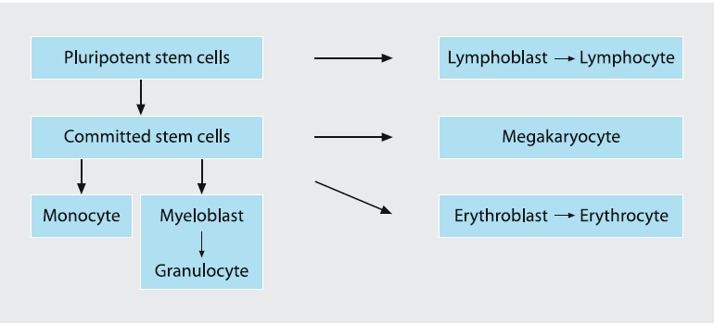
Differentiation during hematopoiesis
8

Slide 9
LEUKEMIA
Accounts for thirty-three percent of all cancers in children
Annually 45 of each million children less than 16 years of age are newly diagnosed as having leukemia
Incidence peaks at 2–5 years
9

Slide 10
Classification
Acute Leukemias
Acute Lymphoblastic Leukemia-80%
Acute Myelogenous Leukemia-20
Chronic Myelogenous Leukemia
Mixed Leukemias
10

Slide 11
Etiology and Predisposing Factors
1. Genetics
Higher risk in the following congenital disorders:
Trisomy 21 (14 times higher)
Other trisomies,
Turner Syndrome
Klinefelter syndrome
Monosomy 7
Neurofibromatosis type 1 (von Recklinghausen disease)
Fanconi anemia (high fragility of chromosomes)
11

Slide 12
Etiology and Predisposing Factors
2.Ionizing Radiation
3.Chemicals and Drugs
Benzene (related to AML)
Chloramphenicol(usually related to ALL)
Chemical warfare agent, i.e. nitrogen-Lost (related to AML)
Cytotoxic agents; e.g. correlation between alkylating agents and Hodgkin disease and others
12

Slide 13
Etiology and Predisposing Factors
4.Infection
Human T-cell leukemia virus (HTLV) T-cell lymphoma in some geographical areas
Epstein–Barr virus (EBV) and occurrence of Burkitt lymphoma
HIV infection
5.Immunodeficiency
Congenital hypogammaglobulinemia, Wiskott-Aldrich syndrome, HIV infection
6.Socioeconomic Situation
Higher incidence of neoplasia in higher socioeconomic groups
13

Slide 14
Pathogenesis
The etiology and/or predisposition indicates a correlation between leukemogenesis and different risk factors:
Higher instability/fragility of chromosomes
Deficiency of the immune response cascade
Certain exposures (ionizing radiation, chemicals, viruses)
14

Slide 15
The prenatal origin of childhood ALL
Concordance in monozygotic twins
Infant ALL close to 100%
1-5 years 20%
Gradual decrease to sibling risk 1-2%
15

Slide 16
Leukemic Cell Characterization and Classification
Morphology
Leukemic cells are characterized by
A lack of differentiation
A nucleus with diffuse chromatin structure, with one or more nucleoli, and
Basophilic cytoplasm
16

Slide 17
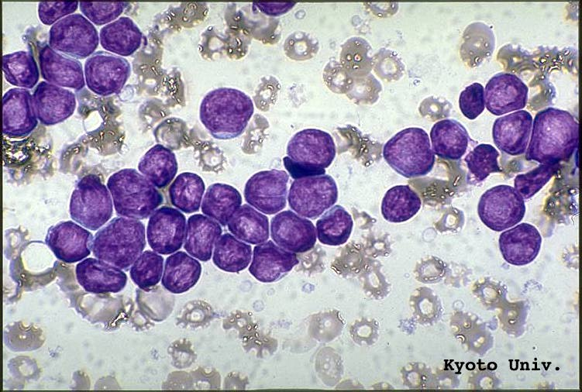
Classification of Leukemias (FAB)-ALL
L1-85% of children with ALL
17

Slide 18
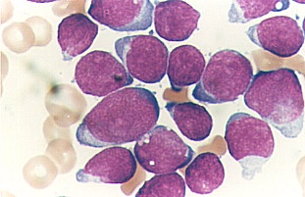
ALL L2(14% of ALL)
18

Slide 19
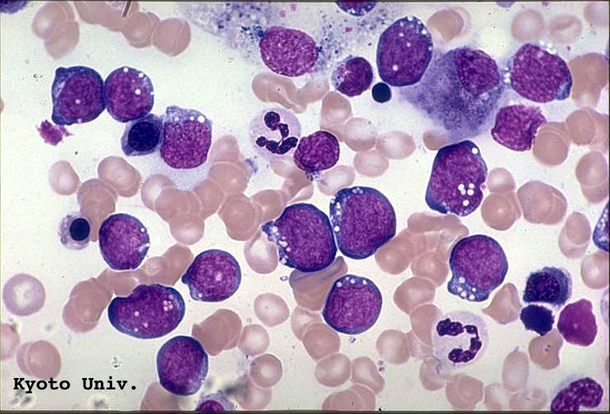
ALL L3(1% of ALL)
19

Slide 20
FAB Classification of AML
M1 A.Myeloblastic without maturation
M2 ‘ “ “ “ “ with maturation
M3 A. promyeloblastic Leukemia
M4 A. Myelomonocytic Leukemia
M5 A. Monocytic Leukemia
M6 Erythroleukemia
M7 A. Megakaryocytic Leukemia
20

Slide 21
Chronic Myelogenous Leukemia
Adult type CML
Juvenile CML
21

Slide 22
ALL Epidemiology
Peak Incidence 2-6 years of age
More frequent in boys than girls
More common in children with chromosomal abnormalities
Risk is higher among identical twins
Environmental factors
EB Viral Infection
22

Slide 23
ALL
How does leukemia present?
23

Slide 24
Inhibition of normal cells
Anemia
Neutropenia
thromobocytopenia
24

Slide 25
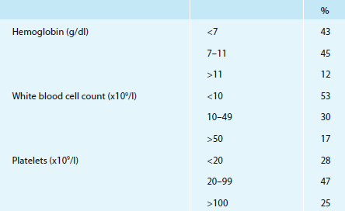
Overview of blood cell counts
25

Slide 26
Leukemia infiltration
Bone pain and bone tenderness
Lymphadenopathy
Hepatosplenomegaly
Mediastinal mass (T-cell ALL)
CNS disease
Testicular disease (ALL>AML)
Gum hypertrophy (AML)
Skin infiltration ( babies)
Localized collections of blasts
-”chloroma” AML
- lymphoma ALL
26

Slide 27
Paraneoplastic
cytokines
Fever, fatigue , loss of appetite, weight loss, night sweats, pruritis
antibodies
-autoimmune anemia, neutropenia, ITP
-autoimmune glomerulopathy (malignant nephrotic syndrome)
27

Slide 28
AML vs ALL
Fever common
Gum hypertrophy
perirectal infiltration
CNS disease 2% AML, 5% ALL
Testicular disease uncommon in AML
Granulocytic sarcomas (chloromas)
DIC particularly APL (M3 AML)
28

Slide 29
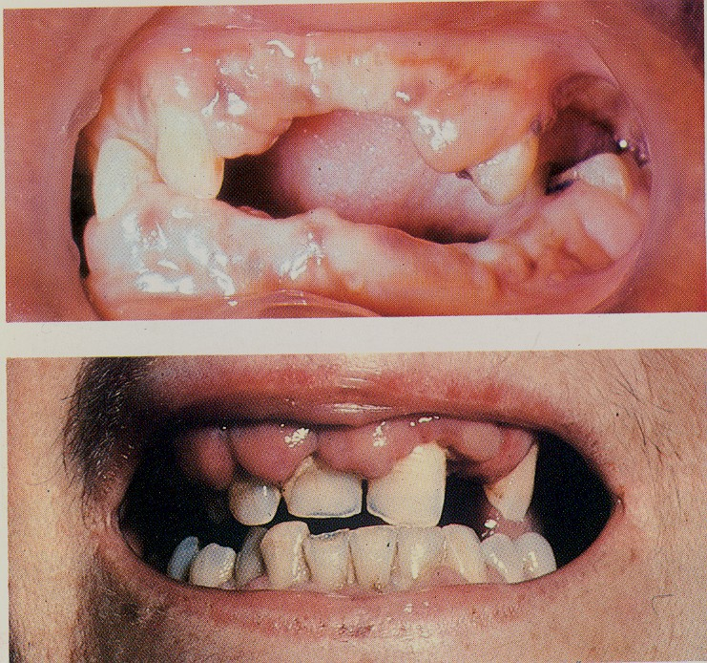
29

Slide 30
Clinical Presentation Specific Signs and Symptoms
Skin
Leukemia cutis (neonatal leukemia)
Chloroma
Central nervous system
in less than 5% of patients
meningeal signs and symptoms or focal neurological signs
Diagnosis by analysis of cerebrospinal fluid CNS I to III
30

Slide 31
Clinical Presentation
Eye| Retinal: infiltration of local vessels, bleeding
Ear, nose, and throat
Lymph node infiltration, isolated or multiple
Mikulicz syndrome: infiltration of salivary glands and/or tear glands
Cardiac involvement
Leukemic infiltration or hemorrhage
cardiac enlargement
Occasionally cardiac tamponade due to pericardial infiltration
Mediastinum
Enlargement due to leukemic infiltration by lymph nodes and/or thymus
superior vena cava syndrome (especially in T-cell ALL)
Pleural and/or pericardial effusion
31

Slide 32
Clinical Presentation
Bone and joint involvement
Bone pain initially present in 25% of patients
Bone or joint pain, sometimes with swelling and tenderness due to leukemic infiltration of the periosteum
32

Slide 33
Diagnosis
Peripheral Blood Film
WBC Most patients may have <10,000cells/mm3
Bone Marrow Aspiration
Bone Biopsy
LP CSF analysis for staging
C-xray for mediastinal involvement
33

Slide 34
Diagnosis-Morphology
Bone marrow analysis
Usually the marrow is hypercellular with uniform
morphology; megakaryocytes are usually absent
Greater than 25% of blast cells necessary for the diagnosis
34

Slide 35
Differential Diagnosis
Leukemoid reaction:
Increased WBC (up to 50×10⁹/l) and/or peripheral immature granulocyte precursors
Bacterial infection
Acute hemolysis
Tuberculosis, sarcoidosis, histoplasmosis
Metastatic tumors
Lymphocytosis:
Pertussis and other viral infections
Infants and small children often have physiological lymphocytosis with an incidence of approx. 85%
35

Slide 36
Differential Diagnosis
Aplastic anemia
Idiopathic thrombocytopenic purpura (ITP):
Bone marrow infiltration by a metastatic disorder:
Neuroblastoma
Non-Hodgkin lymphoma
Rhabdomyosarcoma
Retinoblastoma
Rheumatic fever and rheumatoid arthritis
36

Slide 37
Treatment
Principle of Rx:-
Induction of remission: irradicate leukemic cells from bone marrow
Consolidation therapy
Maintenance Therapy
37

Slide 38
Treatment Outcome
Major impediment is relapse
Bone Marrow relapse 15-20 %
CNS relapse
Testicular relapse in boys -1-2%
In girls ovarian involvement
38

Slide 39
Supportive Care
Manage Tumor Lysis Syndrome
Manage severe Myelosuppression
CPT during and After Chemotherapy
Psychosocial counseling
39

Slide 40
ALL Prognosis
Bad prognostic features
Age <1 or >10
WBC of >100,000
Slow response to initial therapy
Lack of appropriate risk directed therapy
CNS involvement
Mediastinal mass
L3 morphology
40

Slide 41
End
Thank you!

